Slide 1
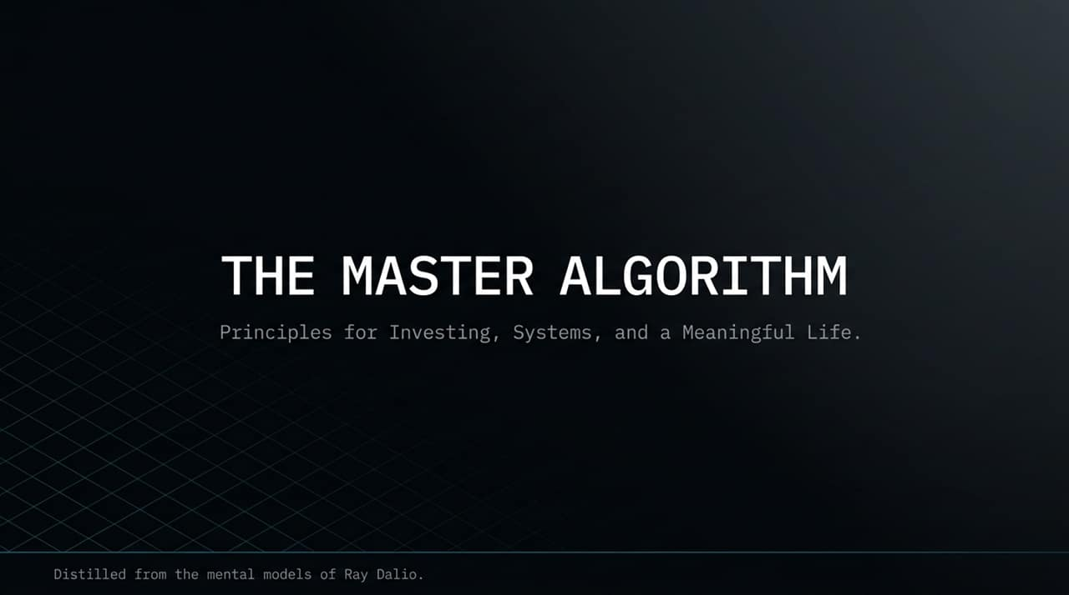
Notes:
Welcome, everyone. Today we are exploring 'The Master Algorithm'—a framework distilled directly from the mental models and lifelong principles of Ray Dalio, founder of Bridgewater Associates.
Whether we look at global macro markets, building resilient systems, or designing our own lives, Dalio's premise is simple: reality operates like a machine. If you understand cause-and-effect relationships, you can codify timeless rules to navigate uncertainty. Over the next 15 slides, we will break down the exact principles—from portfolio design to human capital—that transformed Dalio from a broke trader borrowing money from his father into one of the most successful investors in history.
https://www.youtube.com/watch?v=UprafhdeZVc

Slide 2
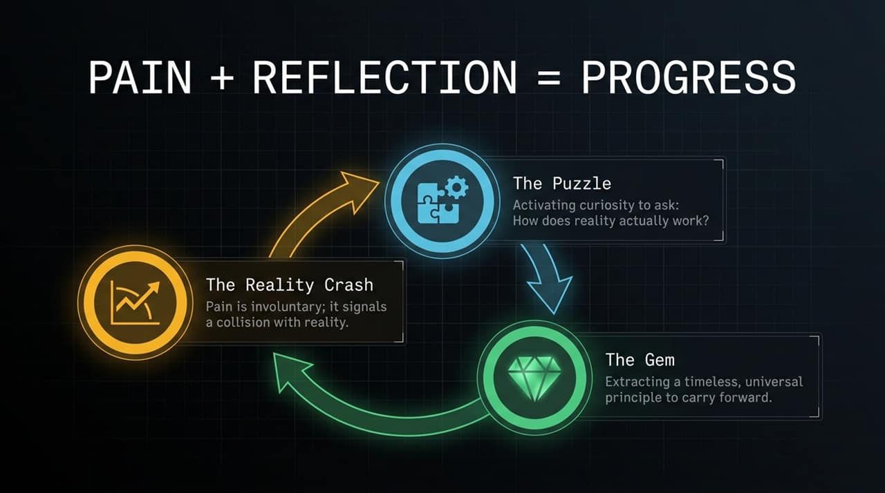
Notes:
Slide 2 presents what Dalio calls the ultimate equation for personal evolution: Pain + Reflection = Progress.
Most people hit a wall when they experience pain. Pain is involuntary—it is reality signaling that your assumptions were wrong. The typical human response is emotional reaction or avoidance. But Dalio treats pain as 'The Reality Crash'.
When pain strikes, you must pause and shift into 'The Puzzle' stage. Activate intense curiosity and ask: How does reality actually work? What cause-and-effect relationship did I miss? If you solve the puzzle, you extract 'The Gem'—a timeless, universal principle that ensures you never make that exact mistake again.
Key Concept: The core engine of personal growth—turning involuntary pain into actionable insights.

Slide 3
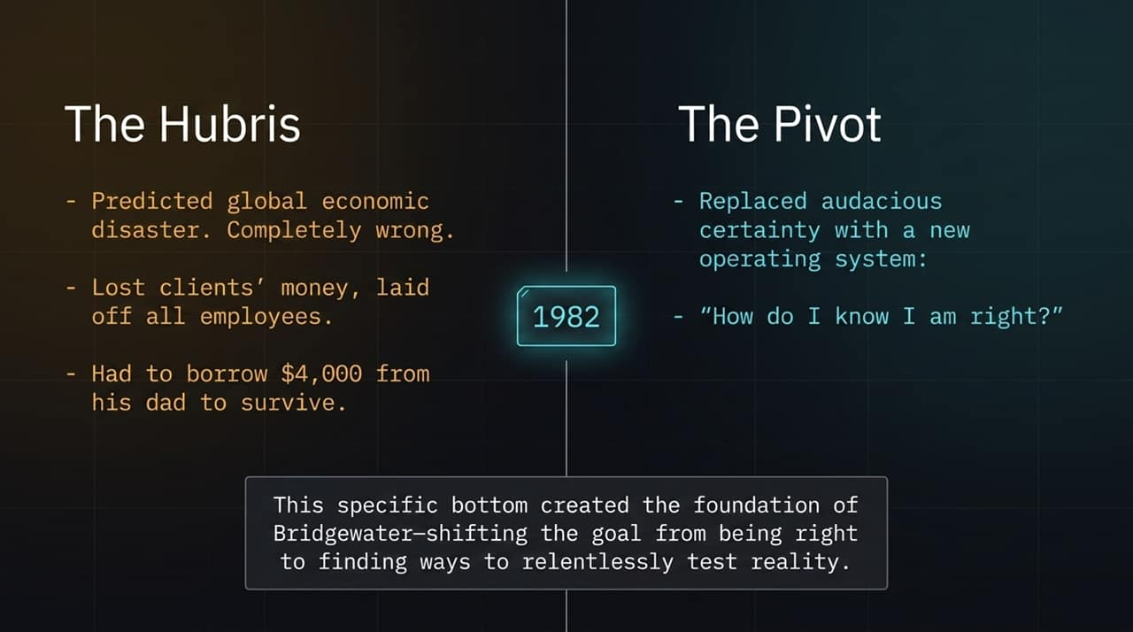
Notes:
To understand why Dalio thinks this way, we have to look back at 1982—the defining crisis of his career.
In 1982, Dalio publicly predicted a global economic disaster due to Latin American debt defaults. Mexico defaulted, just as he predicted, but instead of crashing, the economy boomed. Dalio was aggressively, arrogantly wrong. He lost money for himself and his clients, had to lay off every single employee at Bridgewater, and was so broke he had to borrow $4,000 from his dad just to pay family bills.
This rock bottom forced 'The Pivot'. He realized that audacious certainty is deadly. He replaced 'I know I am right' with the fundamental question: 'How do I know I am right?' That humbling crash shifted his entire goal from being right to relentlessly testing reality.

Slide 4
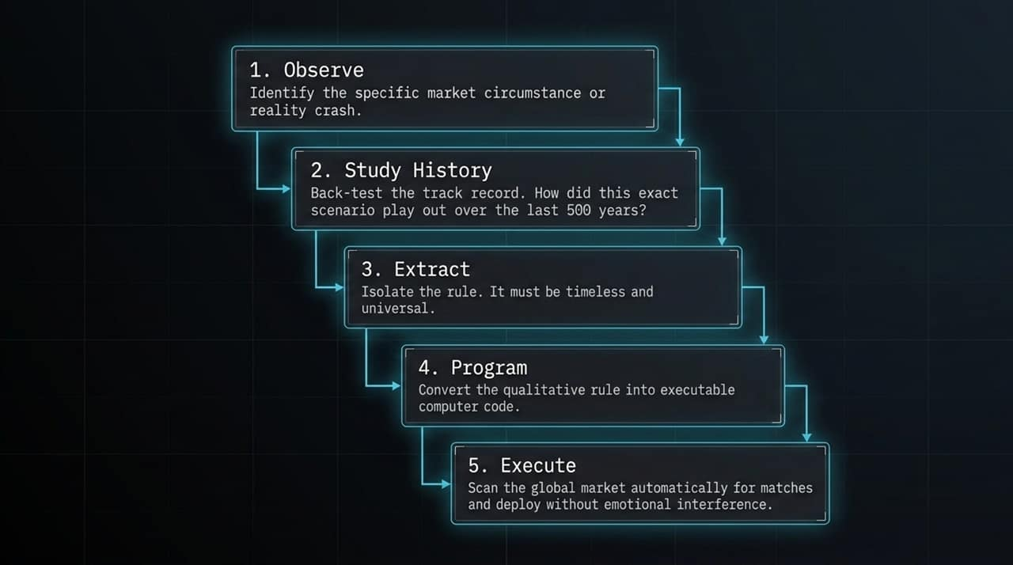
Notes:
How do you translate humility into action? By building systematic game plans. Slide 4 shows Dalio's 5-step loop for systematic decision-making.
Observe: Identify the specific market event or reality crash.
Study History: Back-test the pattern. How did this exact scenario play out over 50, 100, or 500 years?
Extract: Isolate a clear, qualitative decision rule that is timeless and universal.
Program: Codify that rule into executable computer algorithms.
Execute: Let the system scan global markets and trade automatically without emotional interference.
By programming decision rules, you eliminate ego, panic, and cognitive bias.
Key Concept: Converting qualitative observations into executable, automated rules.

Slide 5
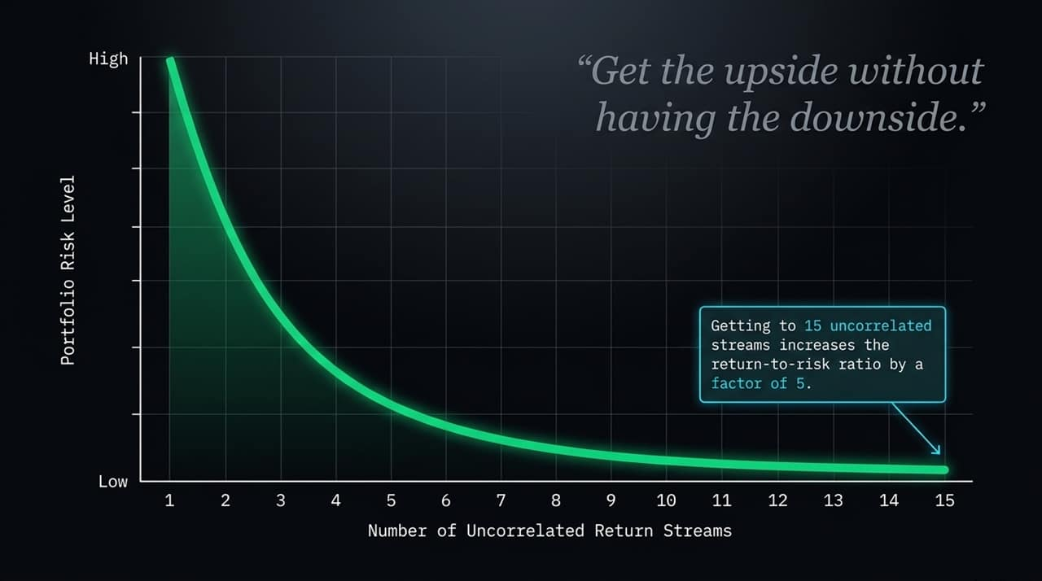
Notes:
In the video interview, Dalio calls this slide 'The Holy Grail of Investing'.
Most investors think diversification means holding 15 different stocks. But if those stocks all move together during a market crash, you aren't diversified.
Dalio studied the mathematics of correlation and discovered a powerful mathematical truth: if you can find 15 good, uncorrelated return streams, you reduce overall portfolio risk level by roughly 80% without lowering your expected return. That improves your return-to-risk ratio by a factor of 5. As the quote says: 'Get the upside without having the downside.’
Key Concept: Reducing portfolio risk by ~80% without reducing expected return.

Slide 6
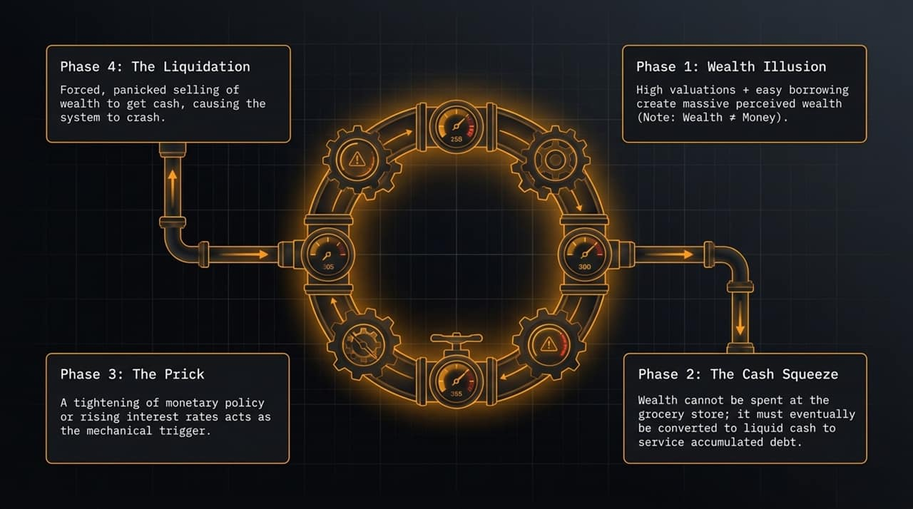
Notes:
"Slide 6 breaks down how economic bubbles form and burst mechanically.
Phase 1 (Wealth Illusion): Rising asset valuations and cheap credit create massive paper wealth. But remember: paper wealth is not liquid cash.
Phase 2 (The Cash Squeeze): You cannot buy groceries or service debt with illiquid paper wealth; eventually, investors need actual cash.
Phase 3 (The Prick): Central banks tighten monetary policy or raise interest rates, acting as the mechanical pin that pops the bubble.
Phase 4 (The Liquidation): Highly leveraged market players are forced to sell assets at fire-sale prices just to raise cash, driving the crash."
Key Concept: The 4 phases of market bubbles and why cash squeezes trigger liquidations.

Slide 7
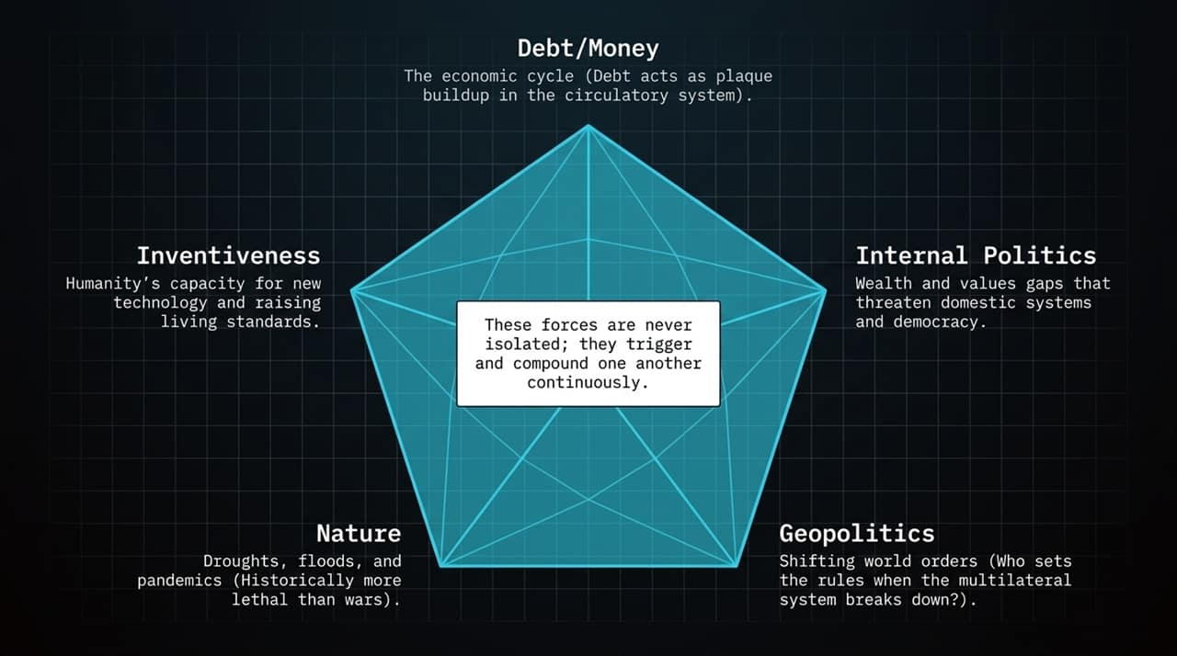
Notes:
Dalio tracks five primary macro forces that continuously interact to drive world history and financial markets:
Debt/Money Cycle: Debt acts like plaque buildup in financial arteries. Squeezes lead to restructurings and money printing.
Internal Politics: Expanding wealth and values gaps create social friction and political instability.
Geopolitics: Shifts in global power lead to order breakdowns and conflicts.
Nature: Pandemics, droughts, and climate events have historically killed more people and disrupted more empires than wars.
Human Inventiveness: Technology and innovation continuously drive long-term living standards upward.
Key Concept: The interconnected forces shaping global macro cycles.

Slide 8
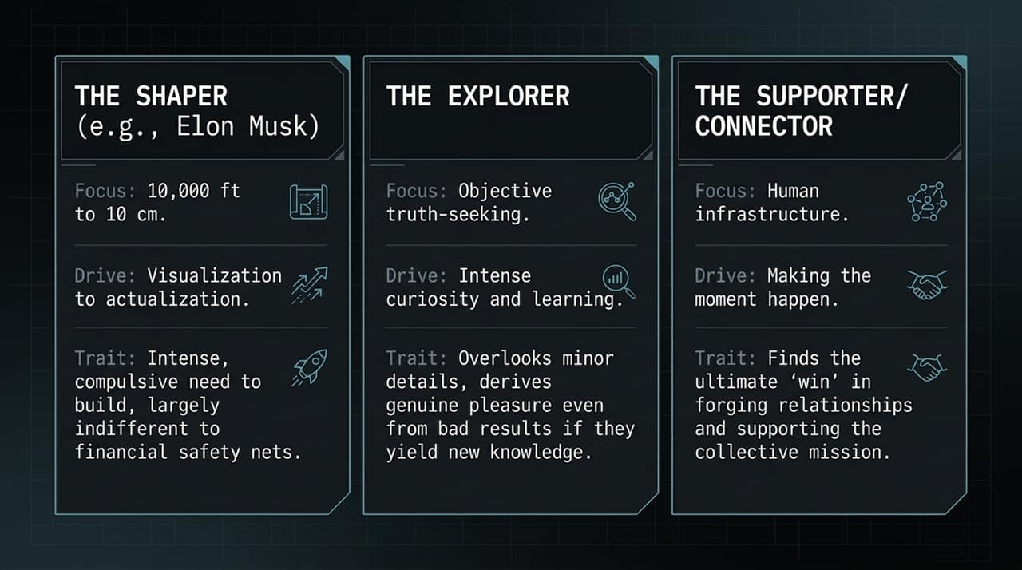
Notes:
To build Bridgewater, Dalio mapped human psychology. Slide 8 illustrates three distinct personality archetypes identified via assessments like PrinciplesFinder:
The Shaper (e.g., Elon Musk, Bill Gates, Dalio): Operates simultaneously at the 10,000-foot vision level and the 10 cm detail level. Driven compulsively to turn mental visions into physical reality, often indifferent to personal safety nets.
The Explorer: Driven by intense curiosity and objective truth-seeking. Enjoys learning even from bad outcomes.
The Supporter/Connector: Builds human infrastructure, forging relationships and uniting teams.
Key Concept: Understanding psychological archetypes to build world-class teams.

Slide 9
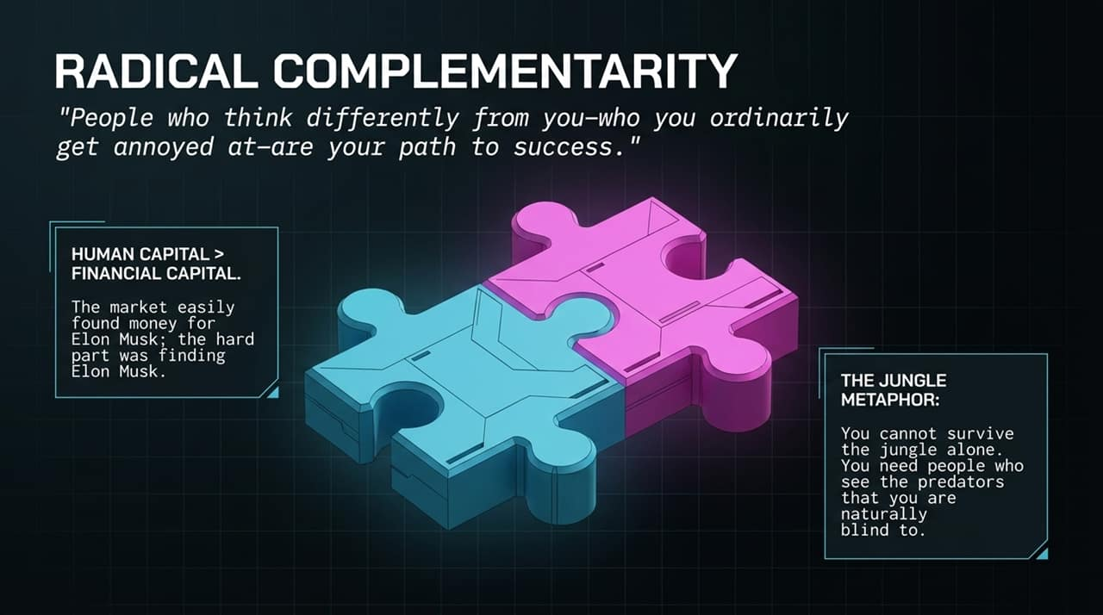
Notes:
Here is the key takeaway: Human Capital > Financial Capital.
As Dalio notes, capital is abundant; the market easily provided billions for Elon Musk, but finding an Elon Musk is the hard part.
Furthermore, Dalio uses The Jungle Metaphor: You cannot navigate the market or business jungle alone. You need people who think differently—people who see the predators lurking in your natural blind spots. True strength comes from radical complementarity.
Key Concept: Human capital trumps financial capital; surround yourself with complementary perspectives.

Slide 10
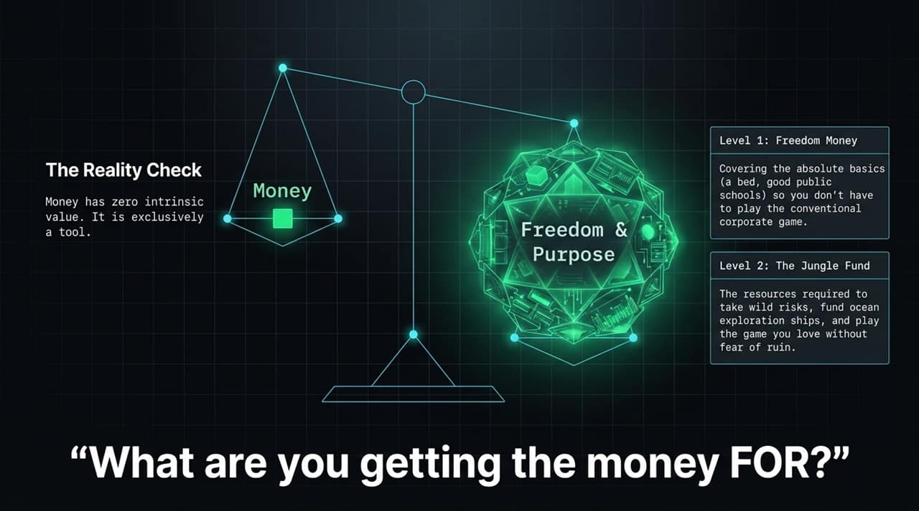
Notes:
Slide 10 addresses our relationship with wealth. Money has zero intrinsic value; it is strictly a tool. Dalio categorizes financial goals into two levels:
Level 1 (Freedom Money): The minimum baseline required to cover basic living needs so you aren't forced into work you dislike.
Level 2 (The Jungle Fund): Capital allocated to take wild, ambitious risks—funding endeavors you love without fear of personal ruin.
Key Concept: Money has zero intrinsic value; define your freedom targets early.

Slide 11
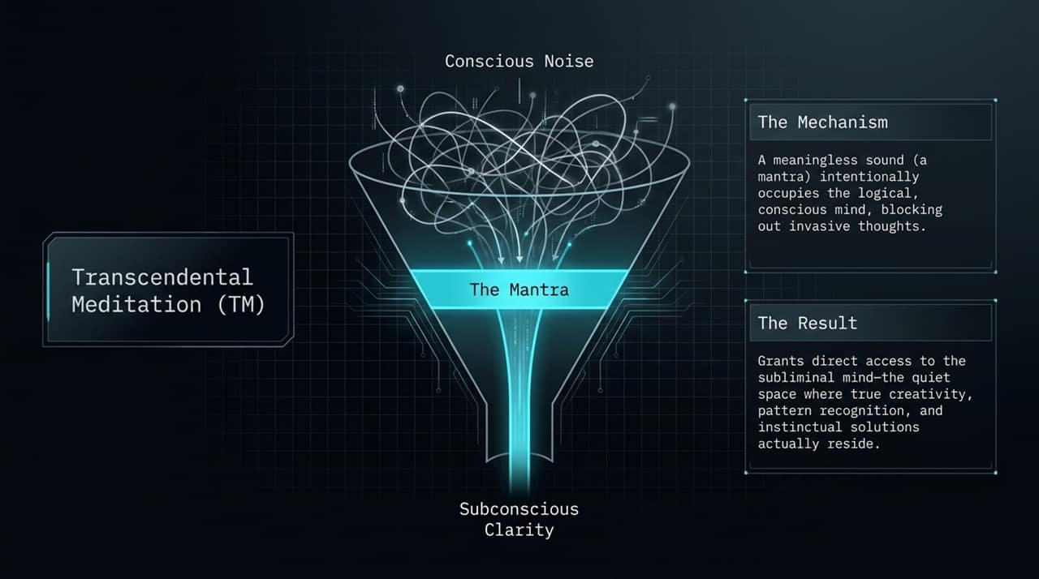
Notes:
A constant force behind Dalio's success since 1969 is Transcendental Meditation (TM).
TM involves quietly repeating a meaningless sound—a mantra—in your mind. This occupies the conscious, logical mind, clearing out noise and anxiety.
When conscious chatter fades, you access the subconscious mind—the quiet space where pattern recognition, breakthrough creativity, and calm decision-making take place.
Key Concept: Using TM to silence conscious chatter and access intuitive creativity.

Slide 12
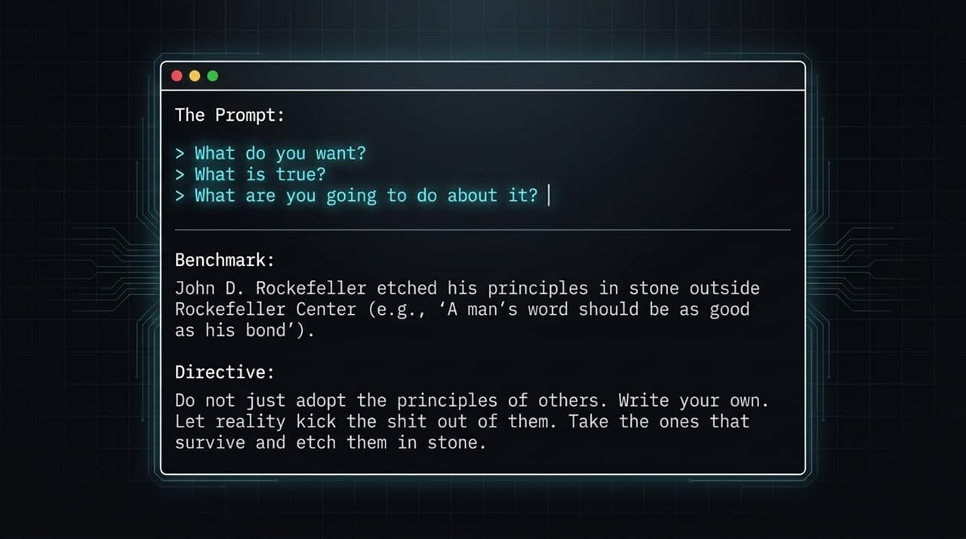
Notes:
Inspiration for Slide 12 comes from John D. Rockefeller, who etched his core values outside Rockefeller Center.
Dalio’s mandate is: Do not simply adopt someone else's principles. Ask yourself three prompts: What do I want? What is true? What am I going to do about it? Write down your principles, test them against reality, keep what works, and etch those rules into stone.
Key Concept: Codifying your personal operating system through real-world stress testing

Slide 13
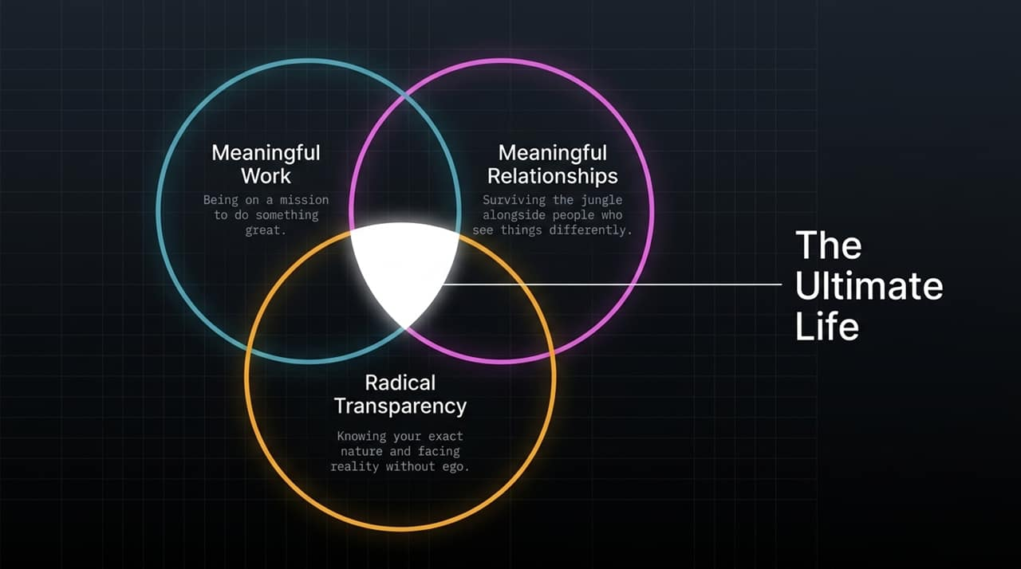
Notes:
What constitutes a successful life? Slide 13 outlines the core pillars:
Meaningful Work: Being on a mission to accomplish something great.
Meaningful Relationships: Crossing the jungle with trusted partners who challenge and complement you.
Radical Transparency: Stripping away ego to embrace self-awareness and objective reality.
'Success is knowing your nature, and finding the best path through that nature...’
Key Concept: Defining true life satisfaction through meaningful work and meaningful relationships.

Slide 14
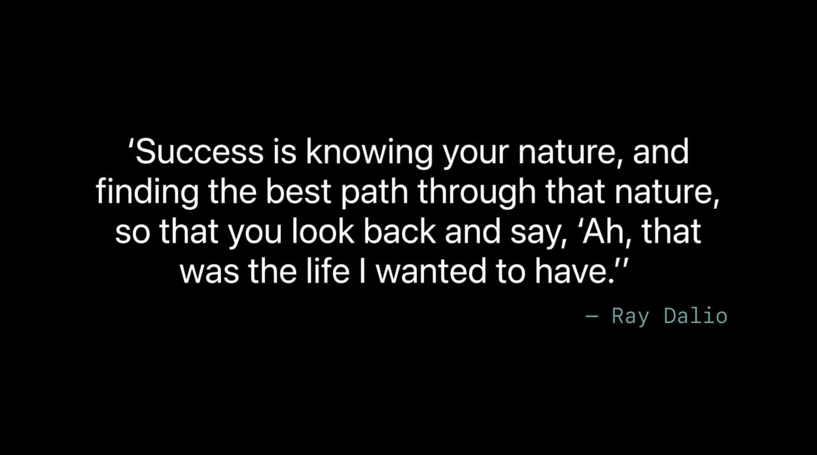
Notes:
Slide 14 brings together the core pillars of Dalio's philosophy:
The Holy Grail of Investing: 15 uncorrelated return streams reduce total portfolio risk by ~80%.
The Personal Progress Formula: Pain + Reflection = Progress.
Know Your Nature & Build Timeless Game Plans: Match your psychological traits with your career, then automate decision rules across long historical cycles.
Key Concept: Recapping portfolio construction, psychological alignment, and systematic back-testing.

Slide 15
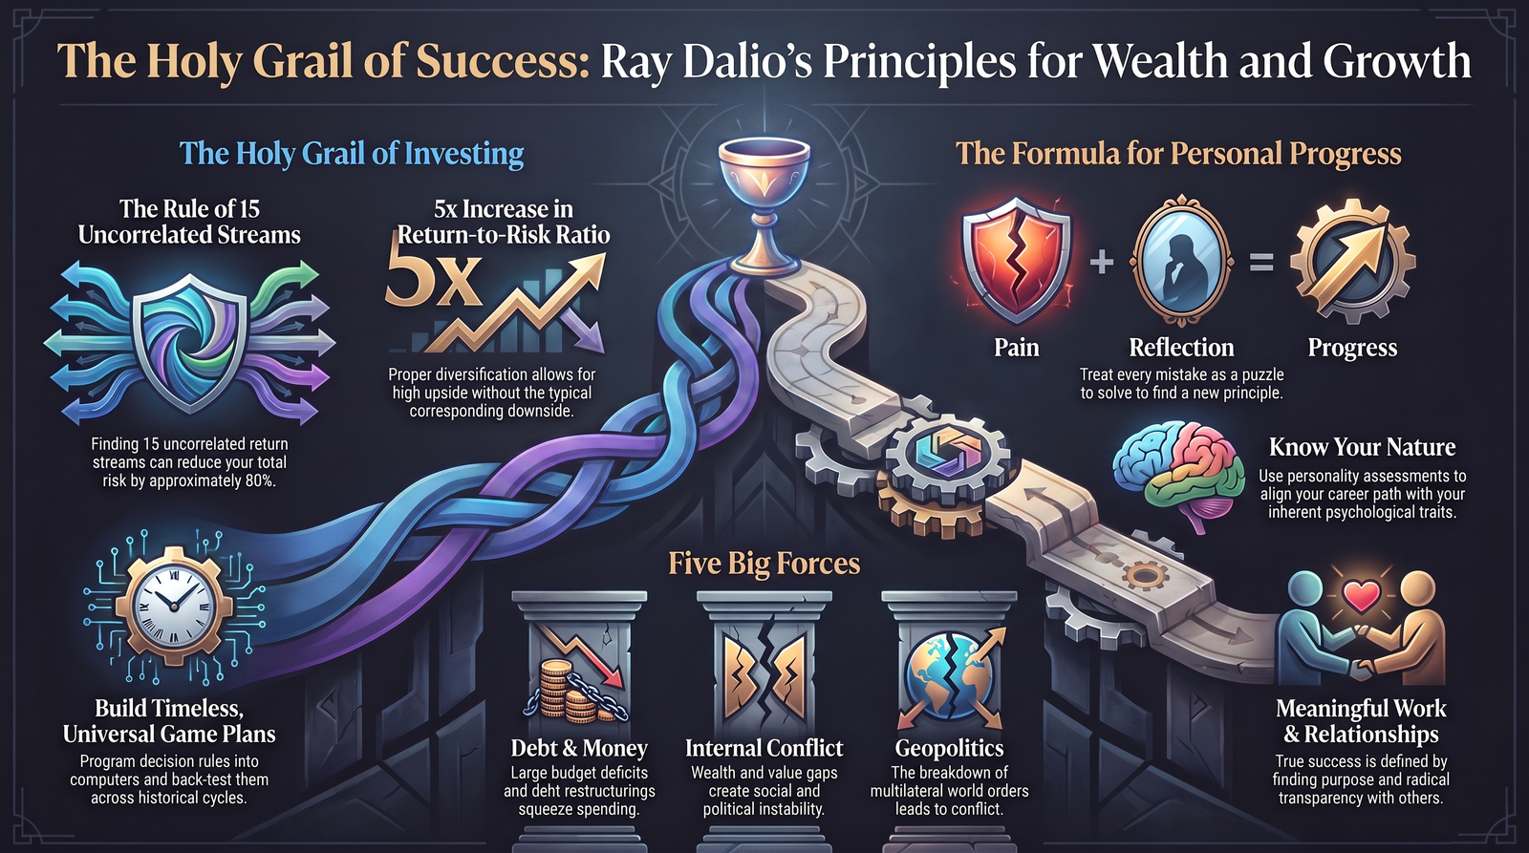
Notes:
Finally, Slide 15 synthesizes the overarching macro picture and personal philosophy.
Always monitor the Five Big Forces—Debt, Internal Conflict, Geopolitics, Nature, and Innovation. At the personal level, measure success by the quality of your work, your relationships, and your alignment with reality.
Thank you.
Key Concept: Macro situational awareness paired with purpose-driven living.

